Slide 1
Deep Learning Activation Functions
by:
Dr. Muhammad Safyan
.

Slide 2
Outline
Sigmoid Function
Pros and Cons
Tanh
ReLU
Leaky ReLU
ELU

Slide 3
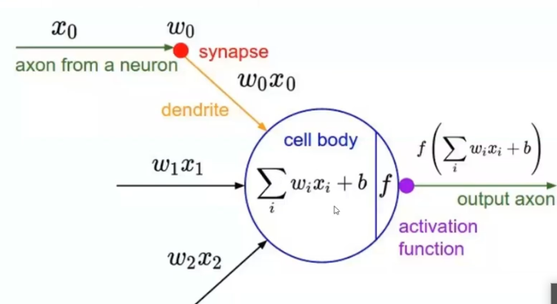

Sigmoid σ
=z
Notes:
Can t creat deep NN

Slide 4
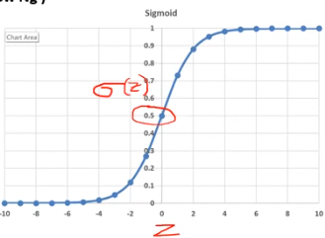
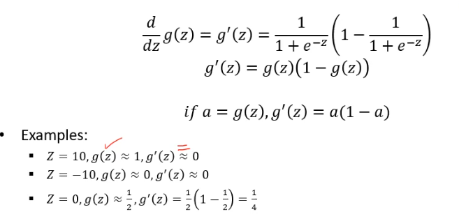
Sigmoid σ
Notes:
Can t creat deep NN

Slide 5
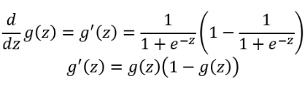
Sigmoid σ
Smooth gradient, preventing jump
Range(0, +1), Normalizing the value of each Neuron.
Clear prediction (0,1)
Gradient vanishing problem → 0 for higher value of z
Data is not zero centric
Power operation is relatively time consuming
Mean round 0 , Less optimal in NN
Very less used in NN
Derivative:
Notes:
Not centered toward zero.
Not bell curve- Normal Distrubution
If data is not zero centeric , more computation power is required to conververge to gobal minima

Slide 6

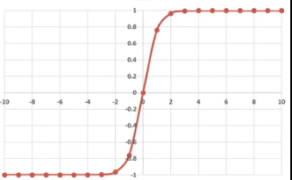

Hyperbolic Tangent(tanh)

Slide 7
Hyperbolic Tangent(tanh)
Shifted version of sigmoid
Range(-1, +1)
0 centric, better than sigmoid
Same Vanishing Gradient Problem→0
Derivative:

Slide 8

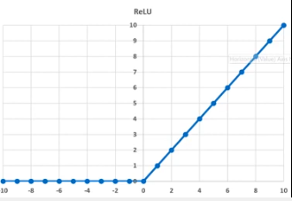
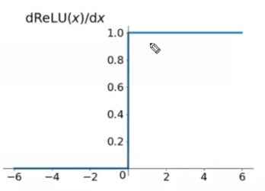
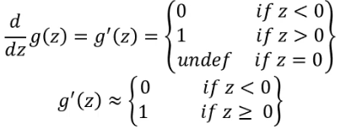
Rectified Linear Unit(ReLU

Slide 9
Rectified Linear Unit(ReLU
Range(0 , infinity)
solve Vanishing Gradient Problem for higher value of Z.
For negative value it derivative become zero.
Grandient undefined for z=0 and z when z<0
Relue dies when having value negative
Derivative:
Notes:
Chain rule if one szero all dervivtive become zero , weigh will not update, call dy relu situation

Slide 10

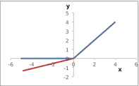
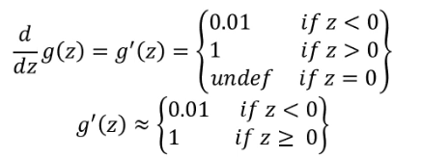
Leaky ReLU

Slide 11
Leaky ReLU
Range(-∞, ∞)
solve Vanishing Gradient Problem for higher value of Z.
Gradient is undefined for z=0 and z
Solve dead neuron problem
Derivative:

Slide 12

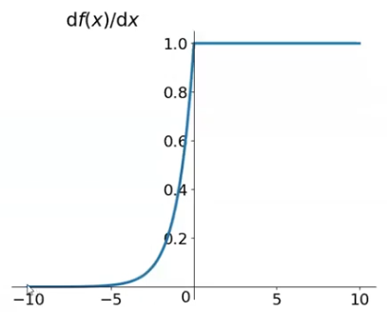
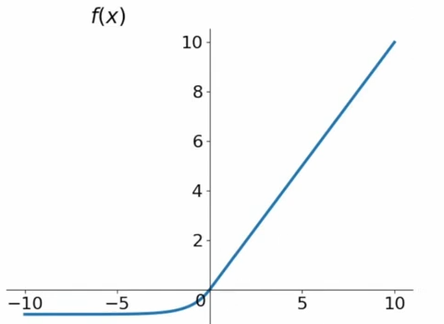
ELU-Exponential Linear Unit
Range(0, 1)
Notes:
Slightly computational expensive

Slide 13
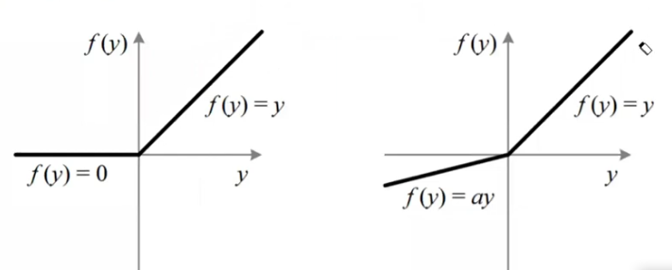
PRelu
Notes:
Slightly computational expensive

Slide 14
Swish Relu
Use for LSTM
Used when having more than 40 layers
Notes:
Slightly computational expensive

Slide 15
Use of Activation function
Which activation function should used
with sigmoid and tanh → vanishing Gradient descent.
With Binary classification
With hidden layer use Relu/ELU/PRelu and in output layer use sigmoid activation function.
with Multi classification use SoftMax activation function in output layer , hidden layer will be same.
With Regression use Relu for hidden layer and Linear activation function for output layer.

Slide 16
Loss function
Cross entropy for Binary classification

